Slide 1


Card Protection Plan
Training Module

Slide 2
CPP Group
CPP is India’s first comprehensive card protection company, which covers the customer’s card in the event of card loss or stolen.
Background of CPP
Founded in 1980 by Mr. Hamish Ogsten
Established in UK in 1981.
Launched in 2008 in India
First company in Europe to offer a centralised “loss reporting service” for plastic cards
The UK market leader in Card Protection
Notes:
At CPP, we believe that life is for living, not worrying. So when things go wrong with you, you should be able to take them in your stride. CPP is here to help you do just that, feel relaxed with our complete service solution available to you 24x7. Just give us a call and we will take care of the rest.

Slide 3


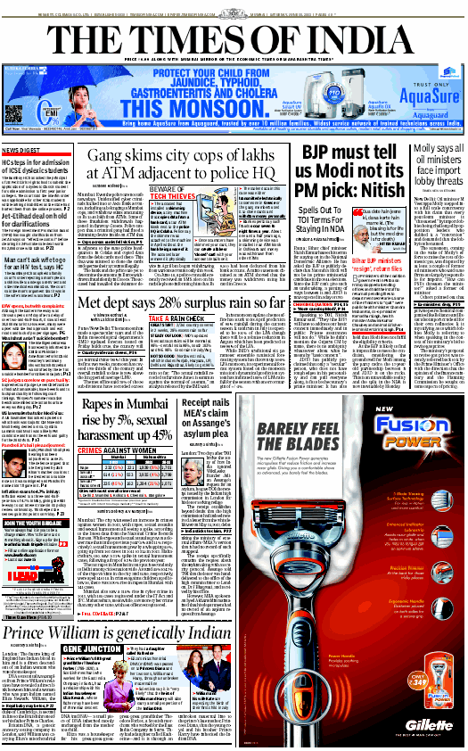

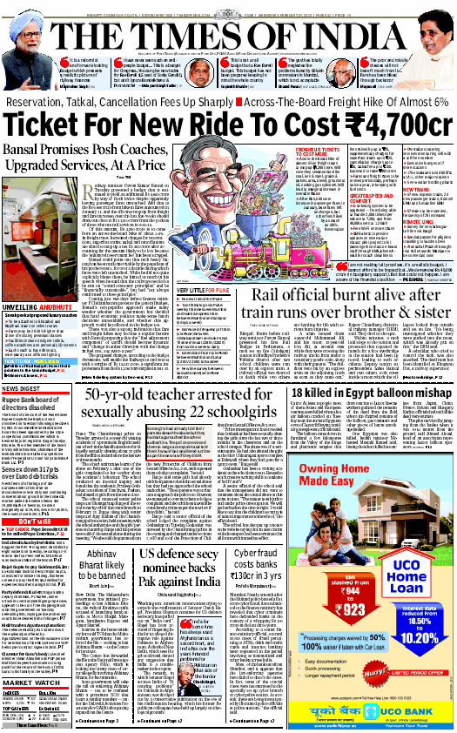
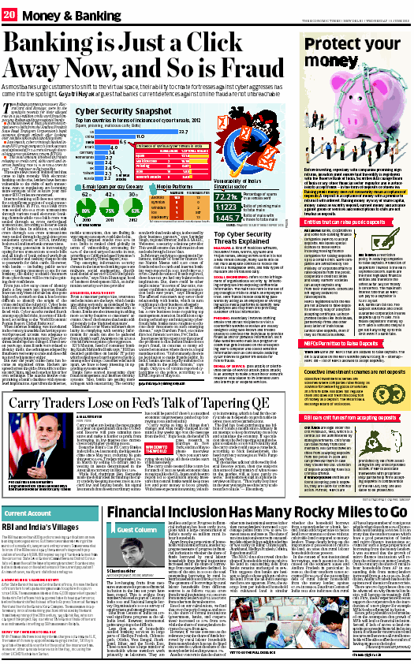
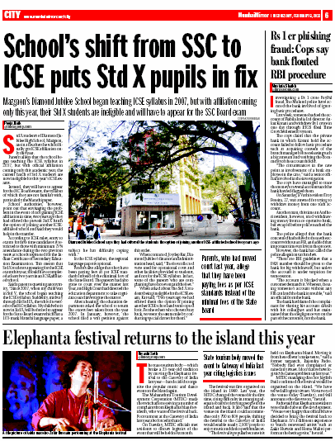
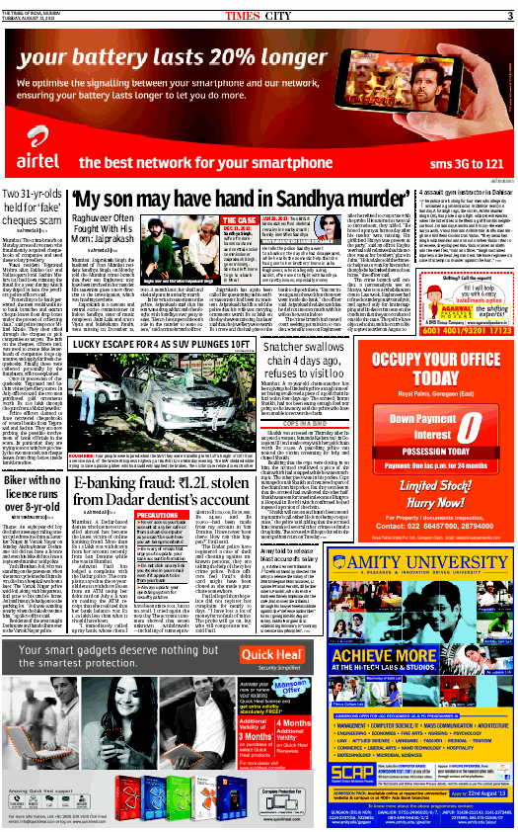

Cards Frauds In India

Slide 4


Why CPP?
No need to panic now
We are here for your
PEACE OF MIND…

Slide 5
Who Provides this Service?
CPP Assistance Services Pvt. Ltd
Updated One Website –: https://india.cppdirect.com/sbi-card
Toll Free Number: 1800-419-4000
Local Chargeable Number: (STD)6000-4000
International Number: (ISD)+91 9212-444-000
Post Office Address ( Communication address)
CPP Assistance services Pvt. ltd.
Post Box No. 826 Kalka Ji
New Delhi - 110019

Slide 6
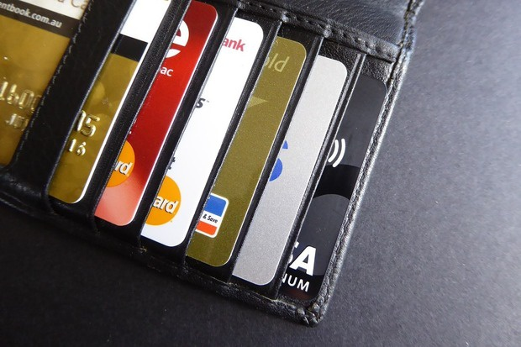
Card Protection Plan benefits
Card Blocking benefits:-
Customer need not provide his/her 16 digit number and expiry date of all lost cards
Customer need not call on different bank’s customer care number
Customer will not face any long Interactive Voice Response (IVR) on this number
Customer can block all bank’s card using one toll free number
(1800-419-4000)
24 X 7 X 365 Available Toll free no.

Slide 7
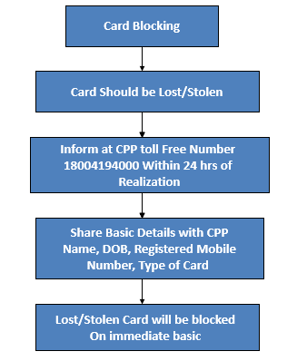

Card Protection Plan benefits
Card Blocking Pitching
CPP has a Tie up with All Indian Bank CPP team calls each of the bank simultaneously; Furnishes information on customer’s behalf to get all customer’s cards blocked.

Slide 8


Card Protection Plan benefits
Emergency Travelling Assistance
Incase customer is traveling out of city or abroad. (min 250 km away from hometown)
Incase of loss of cards, within 24hrs from realization, customer has to call on CPP helpline number and report loss of cards. Cards will be blocked and if customer required CPP will provide executive visit in India within 24hrs and in abroad within 48 hrs.
Customer need not to pay any interest for ETA amount.
Customer can return this amount to CPP within 28 days by DD or cheque. Customer need to call CPP Helpline no for further assistance.
Cash will be provided to primary holder only in every plan within India.
Emergency Travel Assistance | Classic | Premium | Platinum
Emergency Cash in India | Up-to | Up-to | Up-to
 | Rs 5,000 | Rs 20,000 | Rs 20,000
Emergency advance - hotels (Abroad) | Up-to | Up-to | Up-to
 | Rs 80,000 | Rs 12,0000 | Rs 16,0000
Emergency advance - hotels (India) | Up-to | Up-to | Up-to
 | Rs 40,000 | Rs 60,000 | Rs 80,000
Replacement travel ticket advance (Abroad) | Up-to | Up-to | Up-to
 | Rs 80,000 | Rs 12,0000 | Rs 16,0000
Replacement travel ticket advance (India) | Up-to | Up-to | Up-to
 | Rs 40,000 | Rs 60,000 | Rs 80,000
Note:- If customer will not be able to refund the amount within 28 days then its sole discretion of CPP.

Slide 9

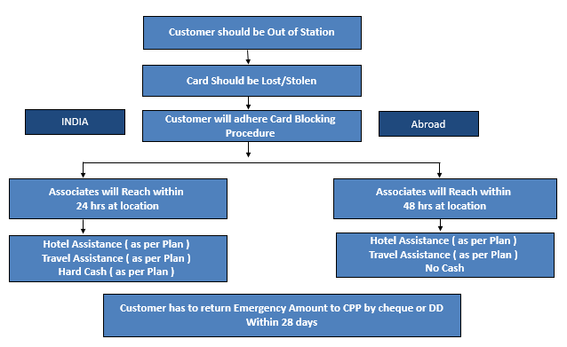

ETA Pitching
Card Protection Plan benefits
Note:- If customer will not be able to refund the amount within 28 days then its sole discretion of CPP.

Slide 10

Card Protection Plan benefits
Fraud Protection
Fraud Coverage Benefit/Pre Fraud Notification:-
Debit / Credit Card Lost & Stolen cover
After realization within 24 hours, customer
has to call on CPP toll free helpline
number(1800-419-4000)
CPP will further go ahead and block all the
lost/stolen cards
Cover to start 30 days prior to lost reporting
CPP offers following Plans :-
Plan | Duration | Price | Fraud Coverage | Members
Classic | 1 Year | Rs. 1,899 | Up-to Rs. 1,00,000 | Primary Card Holder
Premium | 1 Year | Rs. 2,499 | Up-to Rs. 2,00,000 | Primary Card Holder +Spouse
Platinum | 1 Year | Rs. 3,199 | Up-to Rs. 3,00,000 | Primary Card Holder +Spouse +Parents (Only of primary holder)

Slide 11

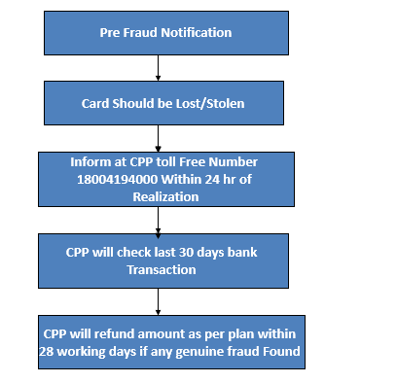

Card Protection Plan benefits
Pre Fraud Benefit Pitching
CPP will cover that Fraud amount too which will not cover by Bank. However, fraud should be genuine which will verify by CPP Investigation Team

Slide 12
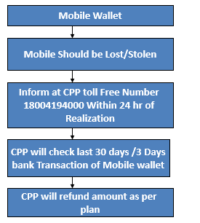

Card Protection Plan benefits
Mobile wallet
If customer mobile gets stolen or lost, customer has to inform on CPP toll free no within 24 hours after realization, then CPP will check last 30 days transaction. If any fraud has been found from Mobile wallet, then CPP will refund the amount up-to Rs. 50,000 (Classic) ; Up-to Rs. 1 Lakh (Premium) and Up-to Rs. 1 Lakh (Platinum).
Mobile wallet pitching

Slide 13
Card Protection Plan benefits
Doctor on call
Member gets unlimited vHealth consultation by qualified and trained doctors
Through the v Health mobile app, one can consult with the in-house doctors by video or by voice call
One can avail teleconsultation for treatment of any illnesses, management of chronic diseases, advice on alternative treatment options and interpretation of diagnostic reports
Using vHealth by Aetna as a first point of contact for any health problem can potentially help to reduce the need for physical consultation by up to 70%!
Multi lingual support available
STEPS TO FOLLOW
Dial v Health by Aetna toll free no. – 1800 103 4466. Services are available between 8 am to 8 pm (Except Sunday & National holiday)
Select your preferred language and you will then be connected to a Tele-medicine Assistant (TMA).
Quote your registered mobile no. to the TMA
TMA will retrieve your membership details and will probe on the medical issue and will complete the below activities:
Customer verification- Name, DOB, Email Id
Captures medical symptom
Height/Weight
Medical report which depends on nature of the medical case
Post Teleconsultation by doctor, member receives the care plan from the respective team of v Health by Aetna or e-Vaidya (as per the language selected for the medical consultation) on the registered email ID and the mobile no.

Slide 14
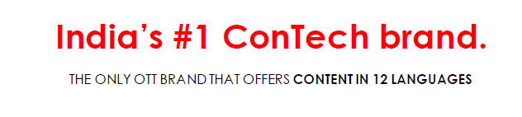

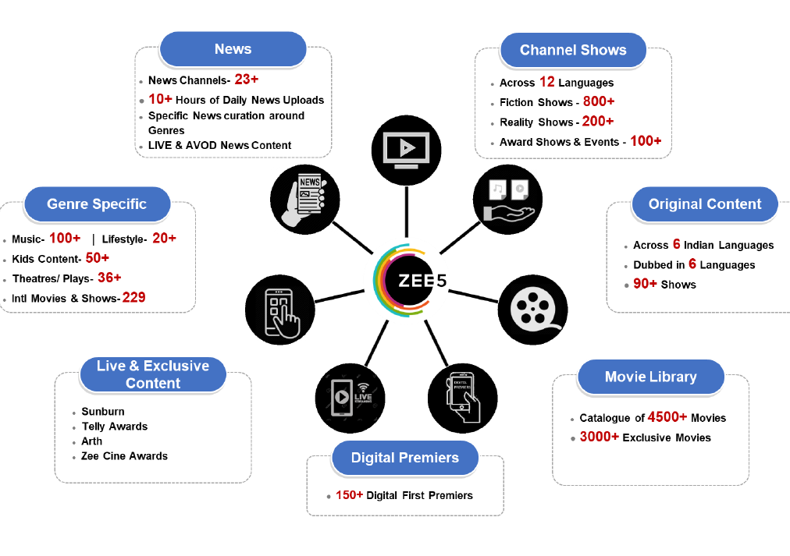
Card Protection Plan benefits
ZEE5 All Access Annual Subscription
Supports 12 Indian Languages
90+ LIVE TV channels, TV shows, 80+ Originals Launched,
25+ Blockbuster Digital Premiers, 3000+ Movies
3 devices can be connected with the annual subscription
1 Lac+ Hours of Content
All Access Annual Subscription for one year – INR 999
Download Instructions
Go to www.ZEE5.com on your Android/iOS smart device web browser
Click on the 3 bar icon on the right hand corner of the ZEE5 homepage (next to the search menu)
Scroll down, click on the 'Have a prepaid code?' tab
Enter the coupon code provided, click on Apply and then click on Continue
Enter your Mobile Number or Email ID and Proceed
Verify using the One-Time Password (OTP) option or Enter Password
Your One Year ZEE5 membership is now active!
Download the ZEE5 App on your smartphone and Login
Enjoy your 12 months ZEE5 All Access Annual Subscription!

Slide 15
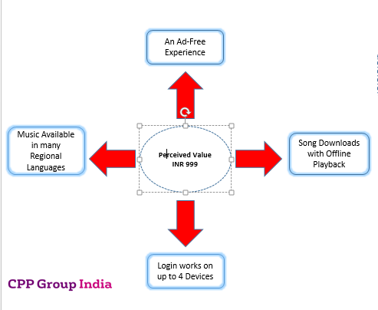
Card Protection Plan benefits
Gaana is the one-stop solution for all the music needs. Gaana offers unlimited access to over 30 million Hindi Songs, Bollywood Music, English MP3 songs, and Regional Music.
Download Instructions
Go to https://gaana.com/redeemcoupon on your web browser and Sign In
Enter the unique coupon code
4 Devices can be connected
Download the Gaana App on your smartphone
Enjoy your 12 months Gaana Subscription
Your one year Gaana Plus subscription is now active! Enjoy streaming songs, song downloads – an Ad-Free experience!
Note: Please use the promo code within 90 days of receipt.

Slide 16
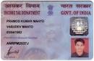
Card Protection Plan benefits
Pan card replacement
Customer will get free pan card replacement benefit from CPP in case of pan card get lost, stolen & damage during CPP membership. CPP has tie up with UTI.
No modification/rectification in information would be done in Pan Card only replacement would be provided. Customer would get Pan Card replacement within 15 working days at registered address free of cost.
Website for PAN application:
www.incometaxindia.gov.in
www.utitsl.co.in

Slide 17
Assistance Services
PAN Card Replacement
We will help you to obtain a replacement PAN card free of cost in case you loose your PAN card. This facility is available in all the plans.
Procedure:-
02 photograph pasted on Pan application in given boxes.
Cross signature on the photograph pasted on top left hand side.
Signature below the photograph pasted on top right hand side.
Signature on signature box given below right hand side.
Address proof of address mentioned on application. Use mentioned format in case of communication address as office address.
Copy of ID proof matched with the name mentioned on application form.
DOB proof as per DOB mentioned on application form.
Website for PAN application:
www.incometaxindia.gov.in
www.utitsl.co.in
Notes:
If cust loses his PAN card before taking the membership then also CPP will assist the cust for re-issuing the PAN card

Slide 18
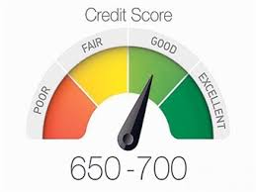
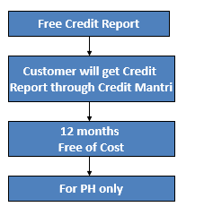

Card Protection Plan benefits
CPP Other Services
Credit Report
Customer will get free access to twelve months retrieval of his/her credit report every year from credit mantri. His/her credit report helps him/her to calculate his/her overall credit worthiness and is useful for applying for loans and credit cards. This is only for PH.
Credit Report Pitching

Slide 19

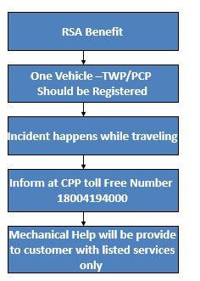
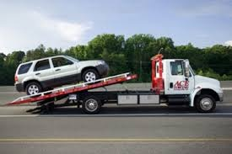
Card Protection Plan benefits
Road side assistance
Under this membership you also get road side assistance service which covers breakdown support, battery jumpstart, flat tyre support ,fuel delivery (paid), vehicle towing up to 75 Km.
Only private 2 wheeler or 4 wheeler customer have to register with CPP for RSA.
This service will be available for your private vehicle in more than 400 locations across India
Road side assistance Pitching

Slide 20


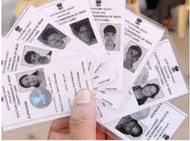
Card Protection Plan benefits
F-Secure
F-Secure Anti-Virus offers decent protection against the viruses, mal-ware and spy-ware which can infect your computer which means all your payments are secure. This is for single user sign on. It can either be installed on one PC or one Laptop and have 1 year validity.
Optional Service
Registered Documents numbers can be registered with CPP as and when customer reports loss of documents, information can be provided to customer.
Note: Any document that has a serial number attached to it can be registered. Customer may register document from Online portal as well

Slide 21
Card Protection Plan benefits
Additional Services
Wing-to-wing execution by one single case-officer for benefit related queries such as card blocking, claim processing, PAN card replacement (Not to be shared proactively)
Personal Case-worker
SMS TO Talk Service
Added communication option allowing customer to get instantaneous call back post sending a simple SMS to a designated number (CPP to 56767). (Not to be shared proactively)
Note:-SMS2Talk and Personal Case Officer service (Only in Premium & Platinum plan)

Slide 22
Card Protection Plan benefits
Additional Services
Call retrieval service:-
Incase customer lost his/her card (Not to be shared proactively) and called CPP toll free number and ask for a new card, then CPP will directly transfer the call to the respective Bank for replacement of a lost card without facing any IVR. (Not to be shared proactively)

Slide 23

Card Protection Plan benefits
How to register cards with CPP?
Tele-registration line:-
Customer can register his/her all cards by-own by calling CPP helpline number and also by visiting the web site he/she can edit the profile info also.
(Not to be shared proactively)
Online membership area:-
Customer can register all his/her cards after receiving welcome kit by visiting CPP web site, this service customer can use as self service portal.
Registration Form:-
Customer will receive registration form in Welcome kit after amount charge as a soft copy on customer’s registered E-mail address within 7 working days post CPP membership activation.

Slide 24
Card Protection Plan benefits
Auto Renewal
CPP Membership is valid for one year, and this is an auto renewal membership registered under recurring transaction mandate. This mandate will be valid till the time you chose to continue with CPP plan and mandate is valid for a sum of Rs. XXX (CPP Plan) up to maximum chargeable value Rs. 5000 in order to avoid renewal lapses in subsequent years.
45 days prior to renewal, a renewal intimation letter, email and SMS will be sent to you. Please ignore if you wish to renew the policy and the membership will renew automatically and charged to your SBI Card/ TATA Card, and if not please call SBI Card helpline or CPP customer service number and ask to not renew the membership. CPP is an optional plan and not mandatory
Tie up
While applying SBI card, you have opt for better information of card protection plan due to which CPP assistance services introduces “Card Protection Plan.” In this service, you will get 10 important benefits.

Slide 25
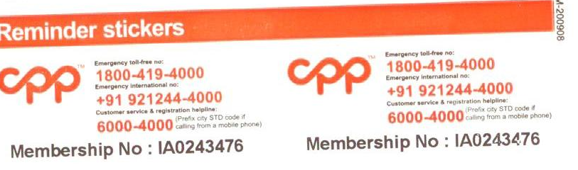
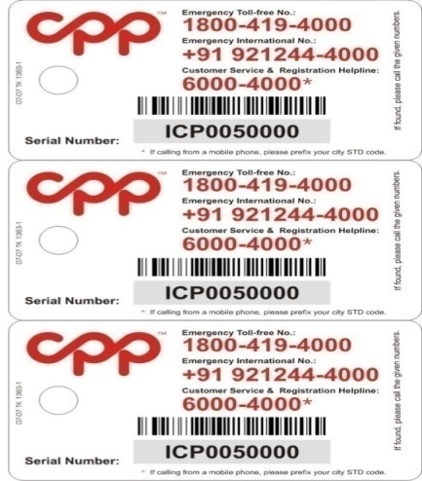
Card Protection Plan benefits
Welcome Kit
After amount charge, customer will get soft copy on customer’s registered E-mail address within 7 working days. customer will get hard copy at his/her registered address as soon as possible.
Registration Form
Terms and Condition
Product information
BRE (Business Reply Envelope) (2)
Key Fob’s (2)
Reminder Sticker (10)
Membership ID with user name and password
F-secure Link and credentials
Credit Mantri Link & Coupon Code
Gaana Plus Coupon Code
Zee 5 Coupon Code

Slide 26
Card Protection Plan benefits
Claim Procedure
Customer has to facilitate following information to CPP :-
Customers will get separate claim kit when they want to raise claim in CPP and when customer blocking his/her cards on CPP number so at that time they can ask for claim kit.
Claim Form (Name, DOB, Bank Name, Type of Card & Fraud Amount)
Subrogation Form (Customer give his authorization to check his
transaction on behalf of customer) on Rs.100 Notary Stamp Paper
FIR/Police Compliant Copy with stamp of local police
Last 3 months bank statement
Self Attested all documents
BRE (Business reply Envelope)
Once CPP receive customer claim documents customer will get the SMS and from that day within 28 working days customer’s claim get settled.
Note:- Customer has to submit claim documents within 30 days

Slide 27
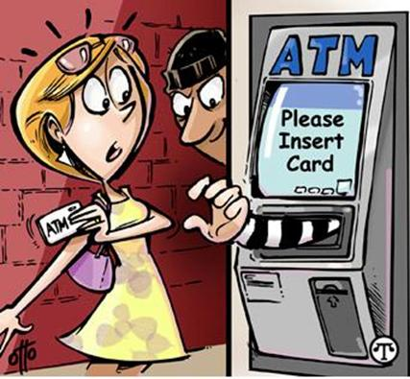

Types of Fraud
Skimming Fraud :- A type of fraud which occurs when an ATM is compromised by a skimming device, a card reader which can be disguised to look like a part of the machine
Counter Feiting :- Counter feiting or “Skimming” is the practice of criminally copying the magnetic stripe on a legitimate credit or debit card through a small handheld device called a “skimmer”. Criminals use the data captured by skimmers to clone and create fake payment cards.

Slide 28


Types of Fraud
Phishing Fraud :- Phishing attacks typically rely on social networking techniques applied to email or other electronic communication methods, including direct messages sent over social networks, SMS text messages and other instant messaging modes
Online Fraud :- Internet fraud refers to fraud that is committed with the help of the internet. Online services are used to conduct fraudulent solicitations, fraudulent transactions, and to transmit the proceeds of fraud to financial institutions. Internet fraud can be committed in web sites, chat rooms, e-mail, and message boards

Slide 29

Types of Fraud
Tele Phishing Fraud :- Tele-Phishing attacks typically rely on fraud calls wherein fraudster to ask credentials by giving lip smacking offers after which customer provide the credentials & thus the fraud happens.

Slide 30



Slide 31
Classic + Card Protection
Card Blocking
Emergency hotel & travel assistance to continue at Rs. 80,000 while abroad and to Rs. 40,000 in India
Emergency cash assistance will be Rs. 5000 in India
Complimentary fraud protection cover amount Rs. 1,00,000
Lost & stolen cover
Online fraud & Phishing cover
Skimming & counterfeiting cover
Cover to start 30 days prior to lost reporting
No limit per card cover
F-secure Anti virus
Doctor on Call
Zee 5 Subscription
Free PAN Card replacement
Valuable document registration/Key fobs/reminder stickers
Number of customers covered in Classic + Plan: 1
Annual Fee
Rs. 1899
Single Member

Slide 32
Premium + Card Protection
Card Blocking
Emergency hotel & travel assistance to continue at Rs. 120,000 while abroad and to Rs. 60,000 in India
Emergency cash assistance will be Rs. 20,000 in India
Complimentary fraud protection cover amount Rs. 2,00,000
Lost & stolen cover
Online fraud & Phishing cover
Skimming & counterfeiting cover
Cover to start 30 days prior to lost reporting
No limit per card cover
F-Secure Anti virus
Doctor on Call
Zee 5 Subscription
Gaana Plus Subscription
SMS2Talk and personalized Case Officer service
Free PAN Card replacement
Valuable document registration/Key fobs/reminder stickers
Number of customers covered in Premium Plan: 2
Annual fee
Rs. 2499
for up to 2 members

Slide 33
Platinum + Card Protection
Card Blocking
Emergency hotel & travel assistance to continue at Rs.160,000 while abroad and to Rs.80,000 in India
Emergency cash assistance will be Rs.20,000 in India
Complimentary fraud protection cover amount Rs.3,00,000
Lost & stolen cover
Online fraud & Phishing cover
Skimming & counterfeiting cover
Cover to start 30 days prior to lost reporting
No limit per card cover
F-secure Antivirus
Doctor on Call
Zee 5 Subscription
Gaana Plus Subscription
SMS2Talk and personalized Case Officer service
Free PAN Card replacement
Valuable document registration/Key fobs/reminder stickers
Number of customers covered in Platinum Plan: 4
Annual fee
Rs. 3199
for up to 4 members

Slide 34
EMI Slab for Card Protection Plan
Tenure | CPP Plan Price (Rs) | ROI (on Monthly Reducing Balance) | EMI | Total Interest | Total Amount Paid by Customer over tenure
Classic
3 Months | 1899 | 14% | 648 | 44 | 1943
6 Months | 1899 | 14% | 330 | 77 | 1977
Premium
3 Months | 2499 | 14% | 853 | 59 | 2558
6 Months | 2499 | 14% | 434 | 103 | 2602
Platinum
3 Months | 3199 | 14% | 1091 | 75 | 3274
6 Months | 3199 | 14% | 555 | 132 | 3331

Slide 35
Summary of benefits
Benefit Summary |  | CPP Card Protection Plan
Category | Benefits in detail | Classic + | Premium + |  | Platinum +
Card Blocking | Single Call to Block Lost Cards | Yes | Yes |  | Yes
Emergency Travel Assistance | Emergency Advance - Hotels - Abroad / India | Rs. 80,000 / Rs. 40,000 | Rs. 120,000 / Rs. 60,000 |  | Rs. 160,000 / Rs. 80,000
 | Replacement Travel Ticket Advance - Abroad / India | Rs. 80,000 / Rs. 40,000 | Rs. 120,000 / Rs. 60,000 |  | Rs. 160,000 / Rs. 80,000
 | Emergency Cash in India (per membership) | Rs. 5,000 | Rs. 20,000 |  | Rs. 20,000
Mobile benefits | SIM & IMEI Registration Service & SIM Card Blocking Service | Yes | Yes |  | Yes
Internet Security | F-Secure Internet Security with Banking Protection (Single Subscription Annually) | Yes | Yes |  | Yes
Health Benefit | Unlimited vHealth by Aetna (Doctor on Call) | Yes | Yes |  | Yes
Entertainment Benefits | Gaana Plus - Music Subscription (Single Subscription Annually) | No | Yes |  | Yes
 | ZEE5 All Access Annual Subscription (Single Subscription Annually) | Yes | Yes |  | Yes
Roadside Assistance | Breakdown support, battery jumpstart, flat tyre support, fuel delivery, vehicle towing | Yes | Yes |  | Yes
Credit Analysis Benefit | Credit Health Report (Single Subscription Annually) | Yes | Yes |  | Yes
Other Benefits | Online Member's Area | Yes | Yes |  | Yes
 | SMS2Talk Service, Designated Case Officer | Yes | Yes |  | Yes
 | Cards, Valuable Document Registration/Reminder Stickers/Key Fobs | Yes | Yes |  | Yes
 | Free PAN Card Replacement Service | Yes | Yes |  | Yes
Complimentary Fraud Protection | Protection against frauds (Transactions involving PIN based Frauds, Phishing, Tele-phishing and Transactions where OTP is not required (if card is lost/stolen)) | Upto Rs. 100,000 | Upto Rs. 200,000 |  | Upto Rs. 300,000
 | Number of days covered (prior to notification) | 30 days | 30 days |  | 30 days
 | Protection against Card Frauds (card present or card not present transactions - other than the transactions listed above) | For pre-notification period of 4 to 7 days
 |  | up to Rs. 25,000 |  | up to Rs. 25,000 |  | up to Rs. 25,000
 |  | For pre-notification period of 7 to 30 days
 |  | up to Rs. 100,000 |  | up to Rs. 200,000 |  | up to Rs. 300,000
 | Mobile Wallet Protection (per Membership) - If there is a simultaneous physical loss of the device | For pre - notification period of 4 to 7 days
 |  | Upto Rs 10,000 |  | Upto Rs 10,000 |  | Upto Rs 10,000
 |  | For pre - notification period of 7 to 30 days
 |  | Upto Rs 50,000 |  | Upto Rs 100,000 |  | Upto Rs 100,000
Members covered | Number of members covered under membership | Primary (1 member) |  | Primary + Spouse (2 members) |  | Primary + Spouse + Parents (4 members)
Prices in Rs. (incl. of taxes) |  | 1899 |  | 2499 |  | 3199

Slide 36
Charging Procedure & Consent
One Shot Charging Procedure
Sir/mam Card Protection Plan ki service ke liye nominal charge hota hai Rs. 2999 lekin abhi apko promotional discount offer kiya ja raha hai Rs.500 jiske baad apko sirf Rs. 2499 amount pay karna hai inclusive of all taxes jo ki aapki sehmati k baad aapke SBI card se charge hoker, Aane wali billing statement mein reflect hota hai aur aap use due date ke according pay kar sakte hain.
EMI Charging Procedure
Sir batana chahunga/chahungi agar aap 3/6 month ki EMI main plan lete hai to aapko 14% monthly reducing balance ke sath EMI amount____ Rs ka rahta hai, isme sir/mam aapko ____Rs ka extra charges rahta hain. Sir Card protection plan ka total charges hota h interest ke sath _____Rs ka
One Shot Consent
Kya aap SBI CARD aur CPP ko authorised karte hai ki apke SBI credit se Card Protection Plan ke liye “Do Hajar chaar Sau ninyaanve Rupayee 2499 Rs ka amount charge kiya jaye. (Please Reply in “Haan” OR “Naa”)
EMI Consent
Kya aap SBI CARD aur CPP ko authorised karte hai ki apke SBI credit se Card Protection Plan ke liye “Do Hajar chaar Sau ninyaanve Rupayee (2499s) charge kiye jaye 14% Monthly Reducing Balance par 3/6 months ki easy EMI par. (Please Reply in “Haan” OR “Naa”)

Slide 37



Separation
Separation
Jo charges aap bata rahe hai yeh card se related charges ho sakty hai, iske liye SBI credit card ke helpline no. par call kar sakte hai 39020202 par.
Yeh charge jo mene aapko bataaya hai ye card se alag hai card protection plan k liye call kiya gaya hai SBI credit card ki taraf se
Sir, mujhe to sirf 500rs/- kuch bataya gaya tha
Mujhe 499rs/- bataya gya tha tbhi maine ha kiya tha
Yeh to life long free service bola gya tha

Slide 38


Optionality
Customer ask "agar ye benefit mai naa lu toh..?”
Smart Agent reply should be like this
Sir /Ma’am Optional service hoti hai.
Chahe toh le bhi sakte hai aur nahi bhi

Slide 39
Objection handling
Scenarios | Corrective Statements
Customer asked “Yeh charge har sal Dena hoga”. What will be the statement delivered by associate? | Sir/Mam, Yeh ek optional cover hai, lena ya na lena aapka decision hota hain, Yeh ek auto renewal service hoti hai, Card Protection Plan ki membership expire hone se 45 din pehle apke registered address par apko ek intimation letter receive hoga, agar aap letter ko ignore karte hai tho services auto renew ho jayegi otherwise aap CPP ke toll free helpline number par call karke services ko discontinue bhi kara sakte hain.
Customer asked “Yeh charge katega kya or yeh charge kaha se katega”. What will be the statement informed by associate? | Sir/Mam, Yeh totally ek optional cover hain, Agar aap CPP service k liye abhi “Haan” bolenge to amount aane wale 7 to 8 working days mein apke SBI card se charge hoga aur upcoming billing statement me reflect karta hain, Agar “Naa” bolenge tho nhi charge hoga.
Customer asked“Yeh one time charge hota hai”…What will be the correct statement? | Sir/Mam, Yeh ek annual charge hota hai Card protection Plan ka, CPP membership k ek saal khatm hone se 45 din pehle apke registered address par apko ek intimation letter receive hoga, agar aap letter ko ignore karte hai to CPP services auto renew ho jayegi otherwise aap CPP k toll free helpline number 1800-419-4000 par call karke services ko discontinue bhi kara sakte hai.

Slide 40
Objection handling
Scenarios | Corrective Statements
Customer asked “Yeh charge mujhe Dena padega”. What will be the correct statement? | Sir/Mam, Yeh totally ek optional cover hain, Agar aap CPP service k liye abhi “Haan” bolenge to amount aane wale 7 to 8 working days mein apke SBI card se charge hota hain aur upcoming billing statement me reflect karta hain. Agar aap abhi “Naa” kehte hain tho amount charge nhi hota hain
Customer asked “Agar main card use nahi karta hu to bhi charges Dena hoga”. What will be the correct statement? | Sir/Mam, CPP service ek alag product hain SBI credit card se, aur yeh SBI card k usage par depend nhi karta hai. Agar aap CPP service k liye abhi “Haan” bolenge to amount apke SBI card se charge hota hain aur upcoming billing statement me reflect karta hain, Agar “Naa” bolenge tho nhi charge hoga.
Customer asked in Right party verification “Maine to sare details bank me diya hai waha se le lijye”. What will be the correct statement? | Sir/Mam, Yeh right party verification SBI card se related nhi hain, Yeh Card Protection Plan k liye hain, aur ye call aapko SBI card se nhi CPP Assistance Services k behalf se ki gayi hain.
Customer asked “Meri card limit kitni hai and card kab tak ayega”. What will be the correct statement? | Sir/Mam, Card related kisi bhi jankari k liye aap SBI card helpline number par call kar sakte hai 39020202, ye call aapko separate ki gayi hai CPP aur SBI card k behalf se card protection plan k regarding.

Slide 41


Thank You !
Bring peace of mind
into your life!

